Slide 1


Green Pace
Security Policy Presentation
Developer: Valerie J. Smith
Notes:
Hello, everyone, my name is Valerie Smith, and I am a developer for Green Pace technology. The presentation today will cover the software security policy that Green Pace has required to protect our software and data.

Slide 2

OVERVIEW: DEFENSE IN DEPTH
The security policy described is representative of a Defense in Depth approach to application security which is a coordinated use of multiple security countermeasures to protect the integrity of the information assets in an enterprise (Eytan, 2022).
Notes:
The security policy presented will assure that our software design processes and build tools are incorporating a Defense in Depth approach, which will help to secure our assets in layers of security countermeasures.

Slide 3
THREATS MATRIX
Security risks have been determined in the threats matrix in order to show samples of code that have resulted in known security vulnerabilities.
Likely STD-005-CPP | Priority STD-010-CPP
Low priority STD-007-CPP | Unlikely STD-006-CLG
Notes:
The threats matrix table shown has been created by analyzing the chosen code stack for common coding errors that have previously resulted in known security vulnerabilities. The table reflects the potential issue with the code stack, and the probability of a security vulnerability. The potential vulnerabilities were found by using the examples from the Software Engineering Institute wiki by Carnegie Mellon University. The potential security vulnerabilities can also be found in code during the development and build parts of the CI/CD pipeline by the use of automated security scanning tools.

Slide 4
10 PRINCIPLES
Validate Input Data | Input data should be assumed to be malicious until it is proven otherwise.
Heed Compiler Warnings | Code should be compiled to use the highest warning level available for the compiler and to eliminate warnings.
Architect and Design for Security Policies | Software architecture should be created, and software should be designed to implement and enforce security policies.
Keep It Simple | Designs should be kept as simple as possible as complex designs increase the likelihood that errors will be made during implementation, as well as during configuration and use.
Default Deny | Access should be denied on default, and access should be based on permission rather than exclusions.
Adhere to the Principle of Least Privilege | The least set of privileges necessary to do the job should be executed for every process.
Sanitize Data Sent to Other Systems | Data sent to complex subsystems should be sanitized.
Practice Defense in Depth | Risks should be managed with multiple defensive strategies so if one layer of defense is not successful, another layer can prevent a security flaw.
Use Effective Quality Assurance Techniques | Quality assurance techniques are often effective at identifying and eliminating security vulnerabilities.
Adopt a Secure Coding Standard | A secure coding standard should be developed that is specifically designed for the programming language that is chosen for the application and platform.
Notes:
10 principals of software engineering have been selected to ensure that security is incorporated into every step of the SDLC lifecycle, creating a DevSecOps environment for Green Pace. Noticeably, the addition of the principal of Defense in Depth has been added to this list. By combining some newer standards with some basic time tested security guidelines, it will be possible to architect and design for security in order to achieve a secure environment.

Slide 5
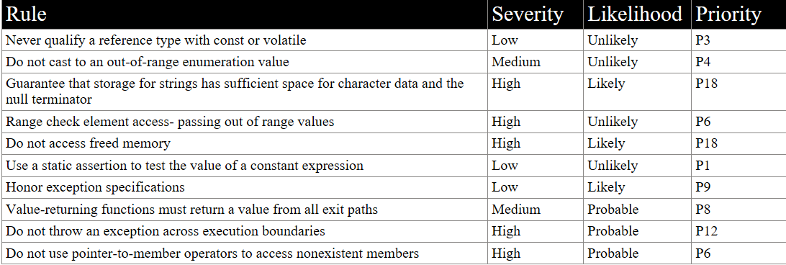
CODING STANDARDS
Notes:
For the Green Pace tech stack, the following coding standards have been analyzed to create a secure coding development environment. The table shows the rule and the likelihood of the potential for a security vulnerability. The severity describes the impact to the business if a security vulnerability is found based on each rule. The priority column orders the priorities by value, for example, the higher the value, the greater the priority for a particular rule.

Slide 6
ENCRYPTION POLICIES
Encryption in rest | Encryption at rest is the act of encrypting data that is being stored while not in use, and sensitive data must have a form of encryption. The purpose of this is to create a layer of defense that the attacker must breach to read the data if it is obtained after previous layers have been defeated. Various encryption methods are available depending on the use of the data, and encryption at rest secures data from those who are not authorized to read it.
Encryption at flight | Data in flight is data that is traveling or data that is being transmitted. Data that is being transmitted should be done with a VPN and behind a firewall. Data that is in flight should be encrypted while being transmitted as if a malicious attacker tries to intercept it, it will be inaccessible to them. Data in flight can be protected with the use of SSL certificates that have private and public key. HTTPS and SSL/TLS protocols should be used to protect data that is encrypted in transit.
Encryption in use | Data that is in use, such as sensitive data such as credit card numbers and passwords, should be encrypted the entire time that they are in use, ensuring that sensitive data is never left unsecured. Data in use should be protected by security tools that monitor for breach detection. Data that it is use should be protected by a role-based access system that limits its access to only those who need it.
Notes:
Encryption policies for Green Pace cover all aspects of data at any stage. Data should be encrypted while it is at rest, such as while being stored or not in use. Data should be encrypted in flight, such as when traveling or being transmitted, and protected with HTTPS, and SSL/TLS protocols. Data in use, such as sensitive data as credit card numbers and passwords, should be encrypted the entire time that they are in use so that they are never left unsecured.

Slide 7
TRIPLE-A POLICIES
Authentication | Authentication will describe how to identify a user and ensure that that user is who they claim to be. A user must have a valid username and a password before being allowed access, whether when using a login, or accessing a database or files. Passwords can be used as well as single sign on systems, biometrics, digital certificates, and public key infrastructures.
Authorization | The next level of authentication is authorization, which describe what the user is allowed to do, or what they are authorized to perform. The user’s level of access should be role based, giving them only the permissions necessary to accomplish a task according to their role. Every user will not need total access, and Administrator access should be given only to those who are making changes to the database and adding new users.
Accounting | Accounting defines what resources were accessed, at what time, and who accessed them, as well as any commands that were issued. Accounting can measure access to the network, session statistics and duration, and the data that was sent and received. Accounting will assure that administrators will be able to view who performed what action, when it was performed, and what they performed at a specific time.
Notes:
Triple-A policies are defined to discover who is accessing the system and what they are allowed to do while they are there. Authentication will identify a user and ensure that they are who they claim to be. Authorization describes what duties the user is allowed to perform with the use of a role-based access system. Accounting will monitor what resources were accessed, who accessed them, what commands were issued, and what data was sent and received.

Slide 8
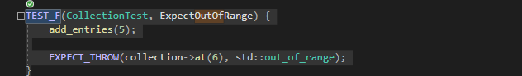

Unit Testing
Verify the std::out_of_range exception is thrown when calling at() with an index out of bounds –memory protection
Notes:
The unit tests shown are examples of testing that is done at the development level as a part of secure coding. These unit tests test the usage of the memory in a collection. As memory is an area where many security vulnerabilities are possible, it is important to ensure that memory management is tested thoroughly. The unit tests were created using the Google Test framework. This test in particular will show that an out of range exception is expected when a collection is given data that is too large for its size. The test detail summary shows that the test was successful.

Slide 9
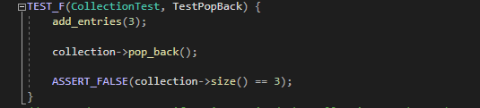

Unit Testing
Verify the popback functionality removes an item from the collection –memory protection
Notes:
This unit test is testing a popular method that alters the size of a collection by removing one element. The test shows that the method removes the element and that the original size is no longer true. A negative test like this one will show that the original statement is now false. The Test Detail Summary shows that the test is successful.

Slide 10
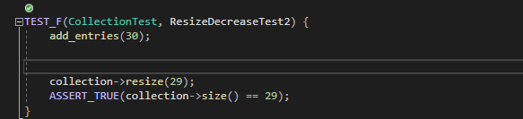

Unit Testing
Verify the collection is resized as stated – memory protection
Notes:
This unit test is testing another popular method to change the size of elements in a collection, which is a critical factor in managing memory in an application. The Test Detail summary shows that the test is successful.

Slide 11
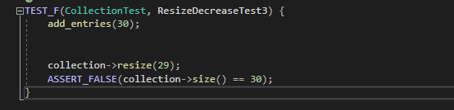

Unit Testing
Verify the collection is resized as stated negative test – memory protection
Notes:
This unit test is also testing the same popular method from the previous slide to change the size of elements in a collection but is implemented using a negative test. The negative test asserts that the original value is not the same. The Test Detail Summary shows that the test is successful.

Slide 12

AUTOMATION SUMMARY
Notes:
The Automation Summary shows the entire flow of the DevSecOps pipeline. In this image, the areas where security is incorporated are shown in every step of the process.

Slide 13
TOOLS
The DevSecOps pipeline is implementing security for both application and infrastructure directly into the DevOps pipeline at the same time the code is being written and while the application is being developed (Malviya, 2022).
External tools used in the DevSecOps pipeline can be including in various development phases, such as in IDE’s where the developer is writing the code and unit testing frameworks, which also may contain IDE plugins and linters (Malviya, 2022).
Repository scanning tools can be used to monitor the codebase for security vulnerabilities and other secrets left in the codebase (Malviya, 2022).
Testing in the pipeline can include Static Application Security testing where source code is scanned for security vulnerabilities such as SQL injection, input validation, Stack/Buffer overflow, and various vulnerabilities included in the OWASP ton 10 (Malviya, 2022).
Security tools such as Dynamic Application Testing, Infrastructure scanning, and compliance checks may be run during the CICD build process prior to deployment (Malviya, 2022).
Monitoring tools can be used while the application is up in order to monitor uptime, identify anomalies, and any malicious activities occurring within the infrastructure/network (Malviya, 2022).
Notes:
Tools that are implemented in the DevSecOps pipeline provide security for both application and infrastructure while the code is being written and as it is being built and deployed. Automation is an important part of the DevSecOps pipeline and covers unit testing and as well as code scanning tools that are scanning for common known security vulnerabilities. Monitoring tools are used to monitor uptimes, identify anomalies, and discover malicious activities.

Slide 14
RISKS AND BENEFITS
For a long time, software security was left until the end of a project, and often left to a different team, or to a security team. The security concerns were outside of the SDLC lifecycle of design, development, and test. Today, there is additional work placed on the developers with bringing security into the SDLC lifecycle. With today’s complex cloud applications, security can no longer be kept separate from the developer’s daily workflow Chenetz (2022).
Steps to prevent threats can be outlined in a security policy, and security should start at the beginning plannings for a project as well as become a part of the software development lifecycle. The steps to prevent threats include access control, data classification, encryption, remote access, acceptable use, patching, malicious code protections, physical security, backups, server security, employee on/offboarding, and change management (Dunham, 2021).
Notes:
There are risks and benefits in DevSecOps as compared to former DevOps methodologies where security was often excluded until the end of the application development or not included at all. As today’s applications are becoming increasingly complex, security can no longer be kept separate or discluded. Benefits of adding security in DevSecOps include preventing threats by the use of access control, data classification, encryption, remote access, acceptable use, patching, malicious code protections, physical security, and more.

Slide 15
RECOMMENDATIONS
An additional recommendation that may not be apparent in the security policy is to ensure that application developers and engineers stay up to date and current in security practices and methodologies (Javed, 2022).
Assuring that the developers have the additional and ongoing training will help them to think critically and better understand security requirements, which saves time and incorporates security from the beginning (Javed, 2022).
With the rapid emergence of cloud platforms, DevOps alone allows for fast and frequent application development, and DevSecOps will allow developers and security professionals a better connection if they are using Agile Methodologies (Javed, 2022).
Agile methodologies will allow for improved communication and collaboration in order to ensure that vulnerabilities are identified earlier in order to avoid cyber-attacks (Javed, 2022).
Notes:
In addition to implementing this security policy, it is also important to ensure that application developers and engineers are participating in continuous education to keep their skill set up to date and to learn about recent security vulnerability issues. Developers that engage in these activities will sharpen their critical thinking skills, saving time and incorporating security from the start. Agile methodologies are recommended as a part of the DevSecOps development to garner communication and collaboration among developers and security professionals in today’s rapid development environment.

Slide 16
CONCLUSIONS
Securing networks, data, devices, and identities will be continued in shaping the future of cybersecurity. Adopting frameworks such as Zero Trust will help companies secure their systems and data in the cloud. Today’s security landscape has become more complex than it ever was before, particularly with the rise of ransomware. Businesses need to be able to recover if they are targeted, and the security policies chosen need to continue to evolve with the business. (Morillo, 2022)
In addition to the Zero Trust, or context-aware security, ransomware threats and attacks will continue and grow to become worse. With the advent of the use of mobile devices for remote work, mobile device security will also become a larger concern. (Morillo, 2022)
Addressing cloud security and automation will become prevalent due to a workforce skills gap or a shortage of professionals. Cybersecurity as a service (Caas) will get more popular for businesses in order to provide extensive security support when building self-managed infrastructures for security are not an option. (Morillo, 2022)
Notes:
In order to conclude this presentation, a look to the future of cybersecurity is necessary in order to understand why the need for a security policy exists. In addition to maintaining and updating the policy, it is important to understand that securing networks, data, devices, and identities will be continued in the future of cybersecurity. A business needs to have the ability to recover when they are targeted, and new frameworks such as Zero Trust are emerging. Ransomware and other attacks will continue and become worse. Mobile device security is becoming more important with the advent of remote work, and addressing security and automation is prevalent due to workforce skills gaps or shortages. A push for cybersecurity as a service is underway.

Slide 17
REFERENCES
Chenetz, M. (2022, September 5). Security needs to shift left into the Software Development Lifecycle. Security needs to shift left into the software development lifecycle. https://stackoverflow.blog/2022/05/05/security-needs-to-shift-left-into-the-software-development-lifecycle/
Dunham, R. (2021, October 26). The importance of a company information security policy. The Importance of a Company Security Policy. https://linfordco.com/blog/information-security-policies/
Eytan, Dr. O. (2022, April 14). Council post: Understanding defense in depth: A layered approach to data security. Forbes.
Javed, A. (2022, March 11). What is DevSecOps and why is it so important?. IBM developer. https://developer.ibm.com/articles/devsecops-what-and-why/
Malviya, N. (2022, September 26). Understanding the DEVSECOPS pipeline. Understanding the DevSecOps Pipeline. https://resources.infosecinstitute.com/topic/understanding-the-devsecops-pipeline/
Morillo, C. (2022, March 15). The Future of Security. O’Reilly Media. https://www.oreilly.com/radar/the-future-of-security/
Notes:
I wish to thank the following references for their knowledge and expertise as a guide in the creation of this presentation. Thank you all for watching.

